Slide 1
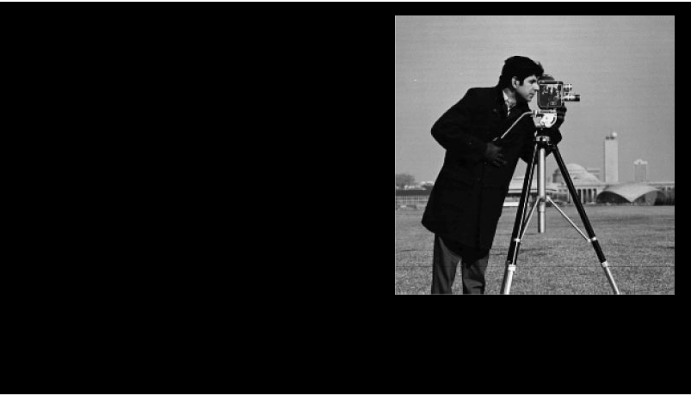
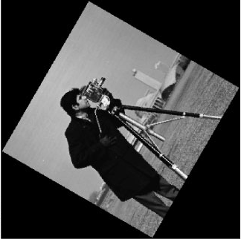
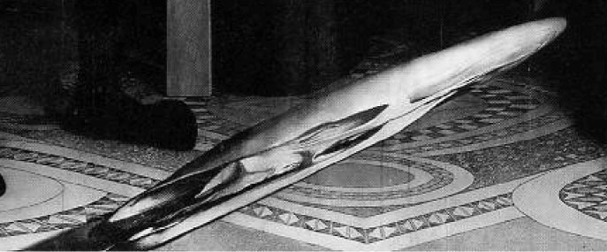
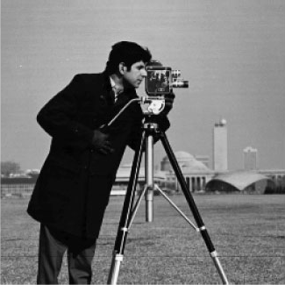
Chapter 6: Image Geometry
Objective: Consider changes of the shape, size,
position and orientation of an image.
Rigid transformations:
e.g.,
translation
and rotation,
Deformable transformations:
e.g., scale change
and warping
6-<number>
Notes:
Rigid transformations(不會變形)
Deformable transformations(會變形)
warpin扭曲(前面物體,後面之地毯則沒扭曲)

Slide 2
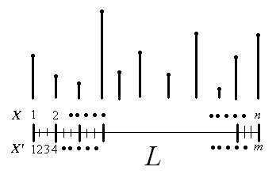
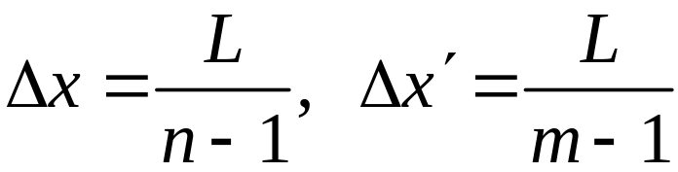
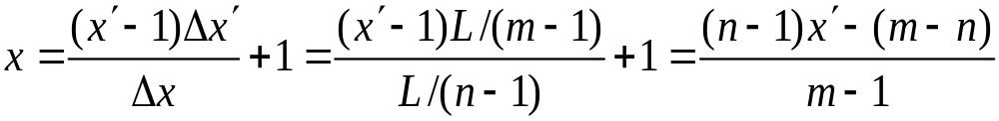
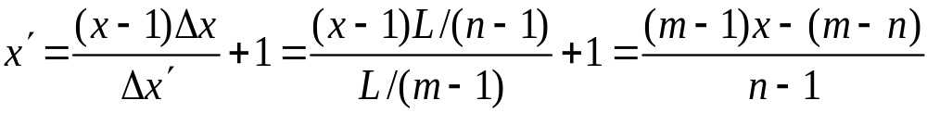
Two major steps for performing a geometrical change of an image: 1) sampling and 2) interpolation
○ Sampling - determines the positions to be filled values
6-<number>
Notes:
geometrical change :
1.決定位置(sampling)
2.決定插什麼值(interpolation)

Slide 3

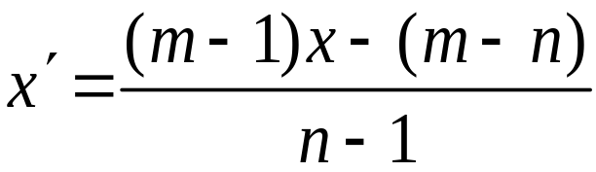
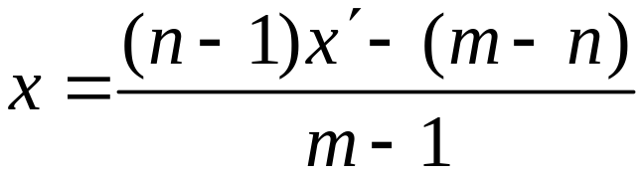

。 Example: n = 4, m = 8
x’ = (7x－4)/3, x = (3x’+4)/7
e.g., x = 2 ➔ x’ = (7·2-4)/3 = 10/3 = 3.33
x’ = 6 ➔ x = (3·6+4)/7 = 22/7 = 3.14
6-<number>

Slide 4
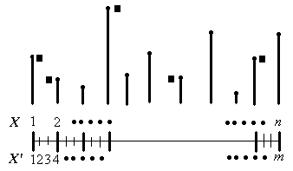
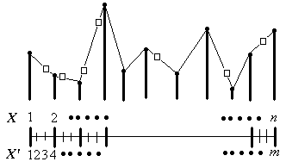
○ Interpolation – determines values to fill the positions
(a) Nearest-neighbor interpolation
(b) Linear interpolation
6-<number>

Slide 5
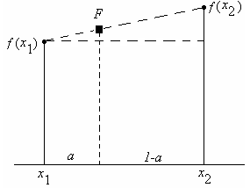
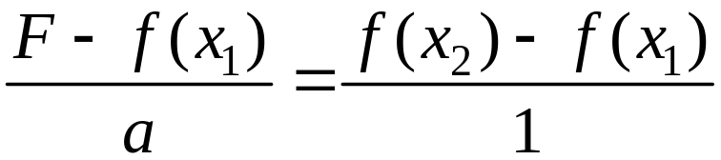
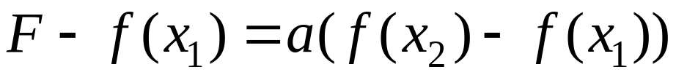
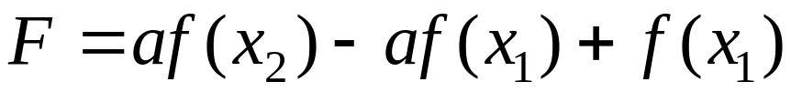
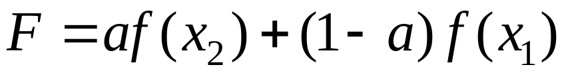
。Example:
6-<number>

Slide 6
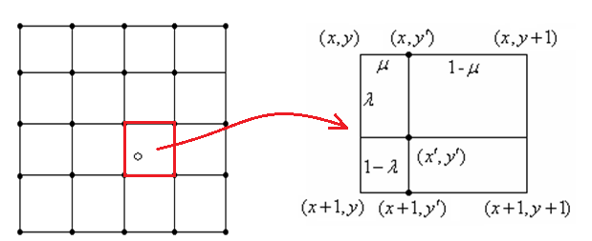
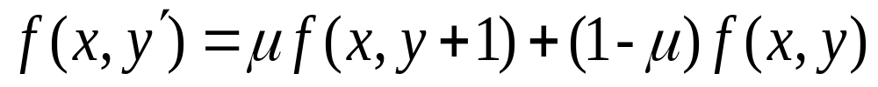
○ Bilinear Interpolation
Step 1:
Step 2:
Step 3:
6-<number>

Slide 7
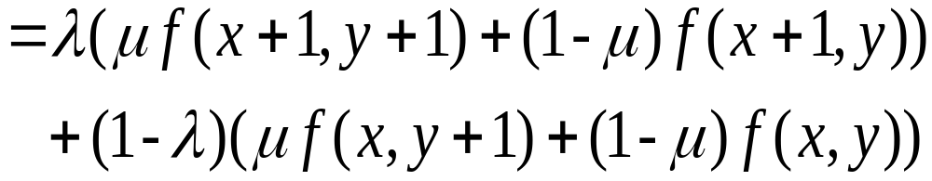
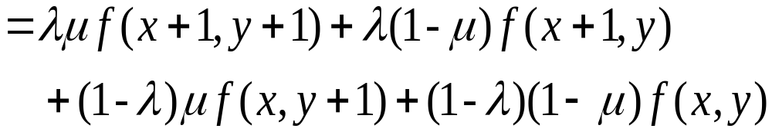
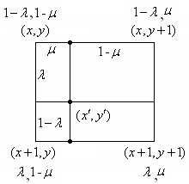
Step 4:
6-<number>

Slide 8


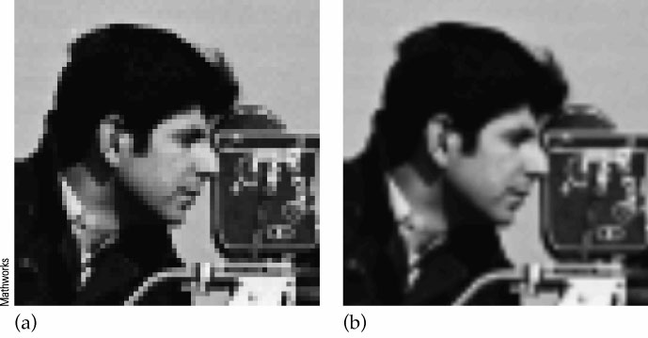
。 Example:
4 × 4 8 × 8
x’ = (7x－4)/3, y’ = (7y－4)/3
x = (3x’+4)/7, y = (3y’+4)/7
NN
Bilinear
6-<number>
Notes:
NN直接copy旁邊,看起來比較多方塊
Bilinear比較smoothe

Slide 9



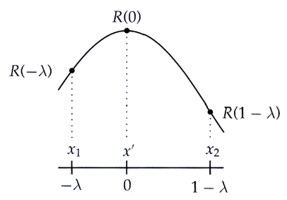


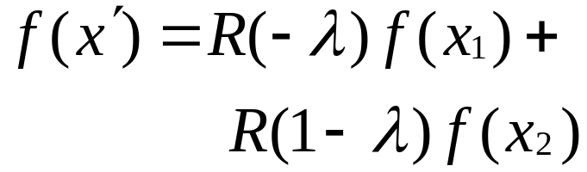
◎ General Interpolation
○ Interpolation functions
Linear interpolation
General interpolation
6-<number>

Slide 10
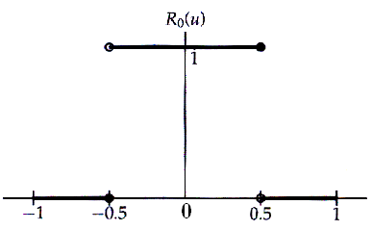
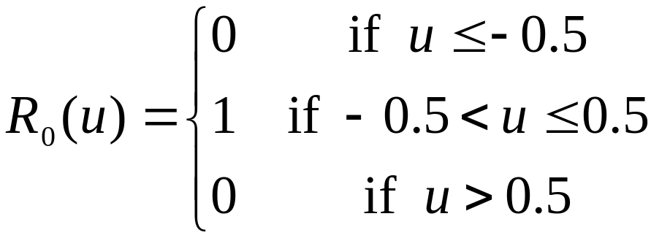
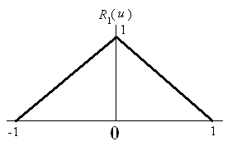
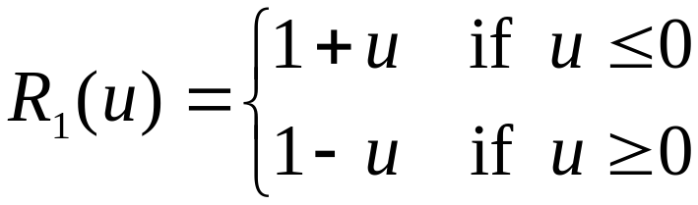
○ Examples:
6-<number>

Slide 11


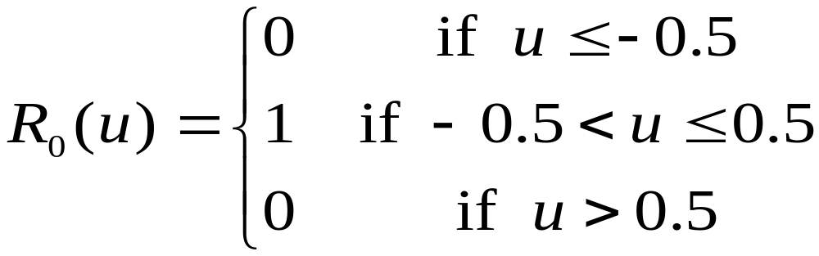
○ Substituting into
NN-interpolation
6-<number>

Slide 12

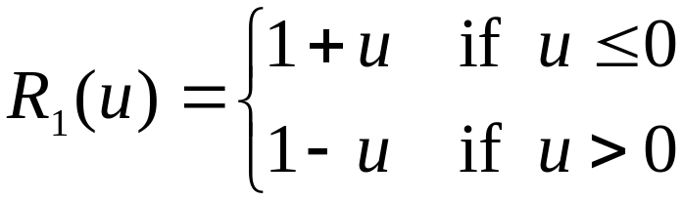
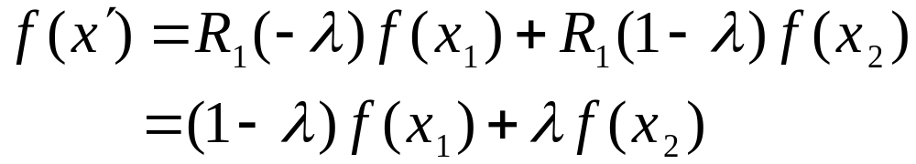
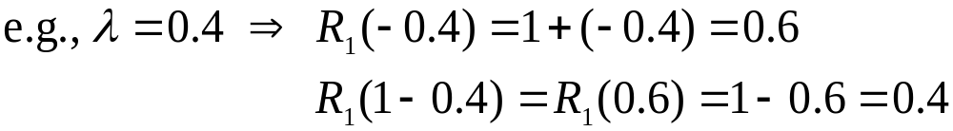

○ Substituting into
Linear interpolation
6-<number>

Slide 13
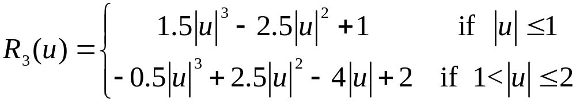
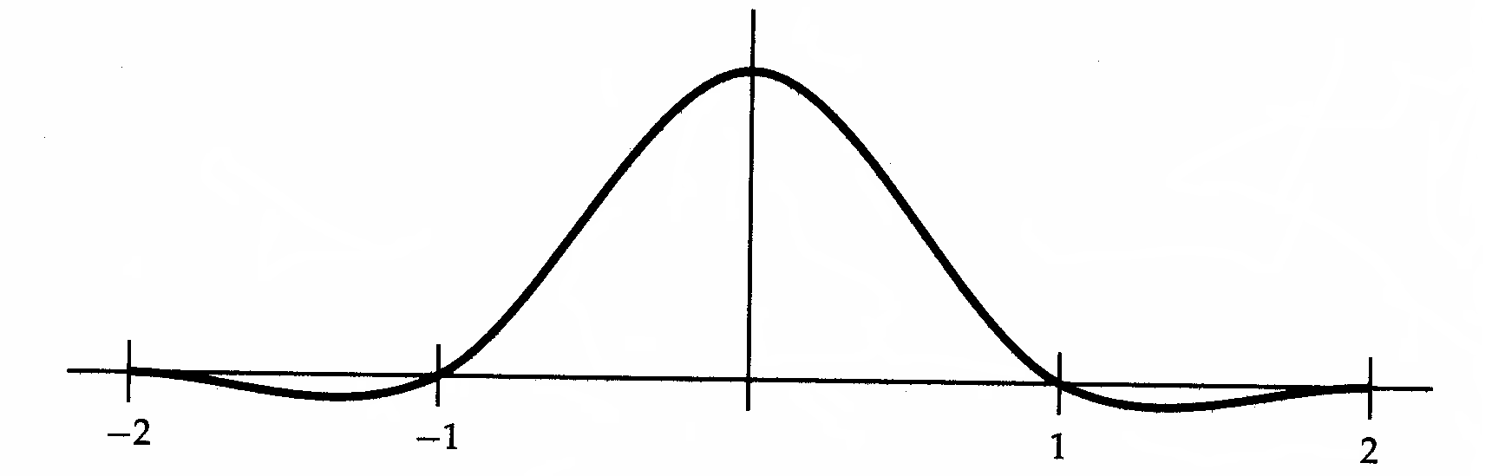

◎ Cubic interpolation function
4 points are needed
6-<number>
Notes:
計算理論中會講到 ,不談

Slide 14
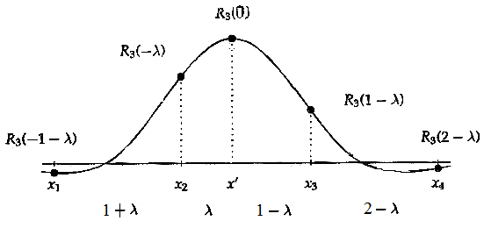
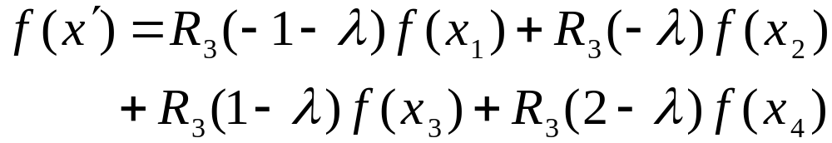
6-<number>
Notes:
r扮演權重角色

Slide 15
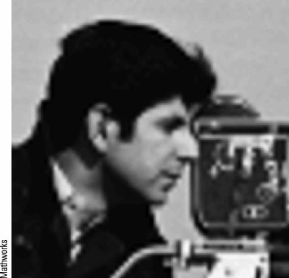
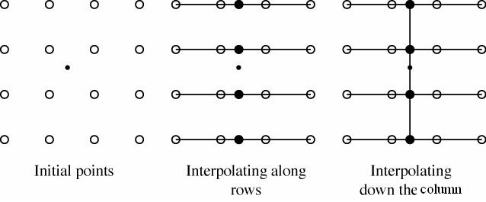
○ Bicubic interpolation
-- Apply cubic interpolation
first along the rows and
then down the columns
6-<number>
Notes:
bilinear interpolation 一次微分都不連續
Bicubic interpolation-二次微分都連續(guarantees the continuity of the first derivatives dS/dX and dS/dY, as well as the continuity of a cross-derivative d ²S/dXdY.)
smoothe程度:Bicubic>bilinear>nn

Slide 16

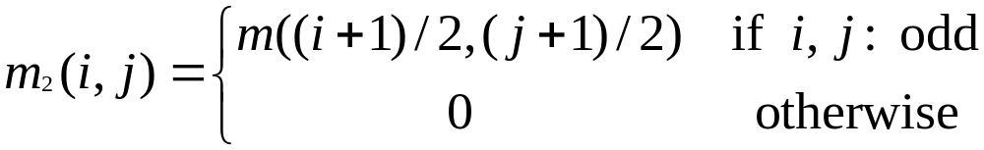

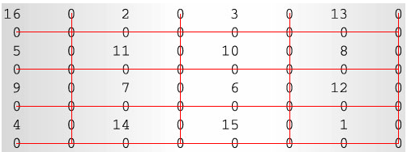
◎ Image Enlargement
m =
Step 1: Zero interleave
e.g.,
6-<number>

Slide 17
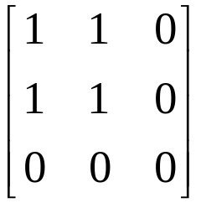


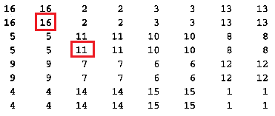
Step 2: Filling
For each pixel, apply
(a) NN interpolation
1/4
6-<number>
Notes:
若兩邊一樣,水平取左邊,垂直取上面

Slide 18
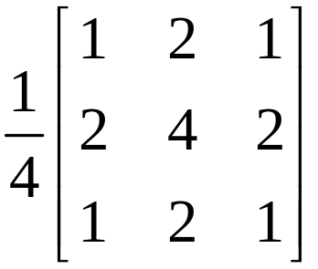

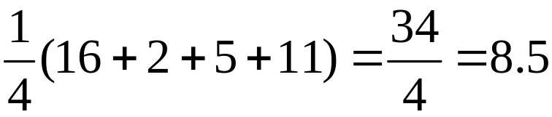
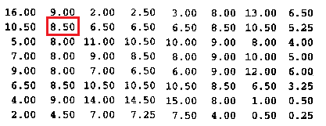
(b) Bilinear interpolation
6-<number>

Slide 19
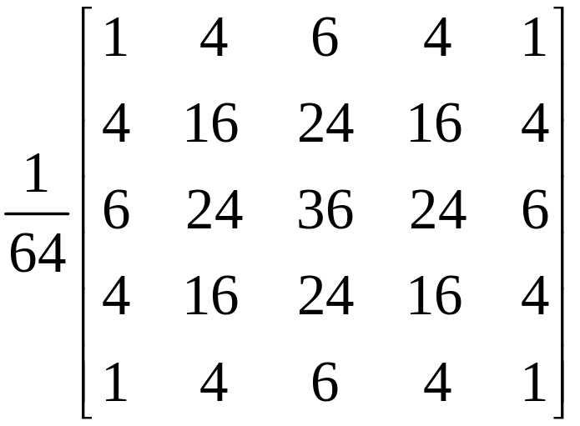
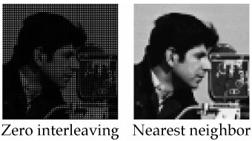
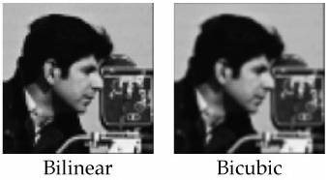
(c) Bicubic interpolation
6-<number>

Slide 20

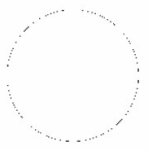

◎ Image Reduction
Subsampling
Edge following
6-<number>
Notes:
可能2點取一點3點取一點
Edge followin彌補空白(容易但有時效果不好)

Slide 21




◎ Image Rotation
Drawbacks:
(a) out of range
(b) truncation error
(c) holes
6-<number>
Notes:
hole原本沒那個位置

Slide 22



Solutions:
Enlarge image size (out of range)
Inverse transformation (holes, truncation error)
NN Bicubic
6-<number>

Slide 23


◎ Anamorphosis
-- Stretch or distort shape of object for artistic or dramatic effect
6-<number>
Notes:
warping

